Slide 1
6
C Arrays

Slide 2
OBJECTIVES
In this chapter you will learn:
To use the array data structure to represent lists and tables of values.
To define an array, initialize an array and refer to individual elements of an array.
To define symbolic constants.
To pass arrays to functions.
To use arrays to store, sort and search lists and tables of values.
To define and manipulate multiple-subscripted arrays.

Slide 3
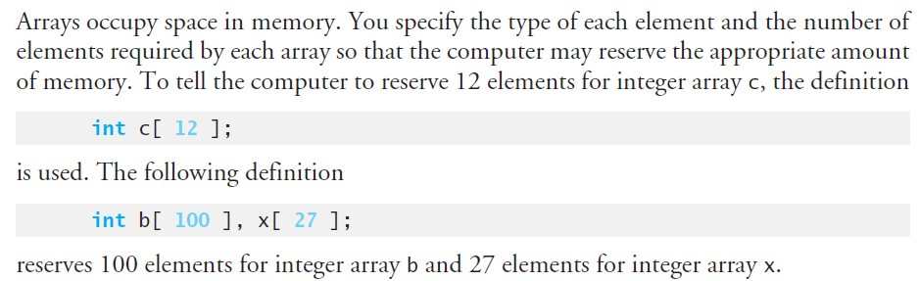
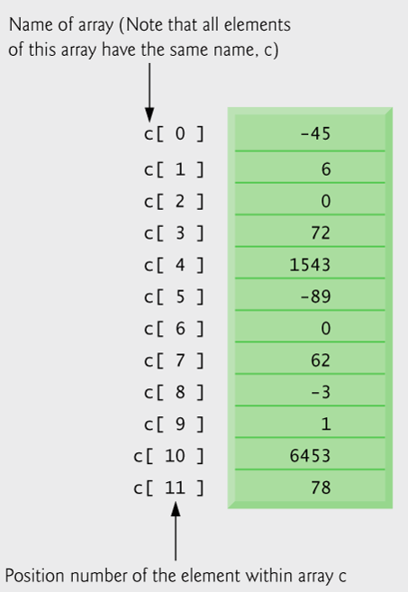
6.1 Arrays
Array elements are like normal variables
c[ 0 ] = -45;
printf( "%d", c[ 0 ]);

Slide 4
Array indexes always start at zero in C
Seventh element of the array is c[6]

Slide 5
Fig. 6.2 | Operator precedence.

Slide 6
6.3 Defining Arrays
When defining arrays, specify
Name
Type of array
Number of elements
arrayType arrayName[ numberOfElements ];
Examples:
int c[ 10 ];
float myArray[ 3284 ];
type
name
number of elements

Slide 7
6.3 Defining Arrays
Defining multiple arrays of same type
Format similar to regular variables
Example:
int b[ 100 ], x[ 27 ];

Slide 8
6.4 Array Examples
Initializers
int n[ 5 ] = { 1, 2, 3, 4, 5 };
If not enough initializers, rightmost elements become 0
int n[ 5 ] = { 0 }
All elements are 0
int n[ 5 ] = { 5, 2 }
Remaining three element are 0
int n[ 5 ] = { 5, 2, 7, 9, 2, 1, 4}
If too many initializers, a syntax error occurs
C arrays have no bounds checking

Slide 9
6.4 Array Examples
If size omitted, initializers determine it
int n[ ] = { 1, 2, 3, 4, 5 };
Number of elements is automatically calculated.
5 initializers, therefore 5 element array.

Slide 10
Outline
fig06_03.c
(1 of 2 )
for loop initializes each array element separately
for loop outputs all array elements

Slide 11
Outline
fig06_04.c
(1 of 2 )
initializer list initializes all array elements simultaneously

Slide 12
Outline
#define directive tells compiler to replace all instances of the word SIZE with 10
fig06_05.c
(1 of 2 )
SIZE is replaced with 10 by the compiler, so array s has 10 elements
for loop initializes each array element separately

Slide 13
Common Programming Error 6.4
Ending a #define or #include preprocessor directive with a semicolon. Remember that preprocessor directives are not C statements.

Slide 14
Common Programming Error 6.5
Assigning a value to a symbolic constant in an executable statement is a syntax error. A symbolic constant is not a variable. No space is reserved for it by the compiler as with variables that hold values at execution time.
#define SIZE 10 /*
7 int main( void )
8 {
9 /* symbolic constant is not variable. */
SIZE=45; /* couses a syntax error */ …. ….

Slide 15
Software Engineering Observation 6.1
Defining the size of each array as a symbolic constant makes programs more scalable.

Slide 16
Good Programming Practice 6.1
Use only uppercase letters for symbolic constant names. This reminds you that these are symbolic constants. They are not variables.
#define SIZE 10 /*

Slide 17
Outline
fig06_06.c
initializer list initializes all array elements simultaneously
for loop adds each element of the array to variable total

Slide 18
Outline
#define directives create symbolic constants
fig06_07.c
(1 of 2 )
frequency array is defined with 11 elements
responses array is defined with 40 elements and its elements are initialized
subscript of frequency array is given by value in responses array
In the given list, number of ‘1’s is counted by frequency[1], number of ‘2’s is counted by frequency[2] and so on..

Slide 19
Outline
fig06_07.c
(2 of 2 )

Slide 20
Error-Prevention Tip 6.1
The array subscript should never go below 0 and should always be less than the total number of elements in the array (size – 1).
int n[ 5 ] = { 0 };
int n[ 6 ] = 7;
A logic error occurs.
No syntax error

Slide 21
Outline
fig06_08.c
(1 of 2 )

Slide 22
Outline
fig06_09.c
(1 of 2 )
‘1’s is counted by frequency[1], ‘2’s is counted by frequency[2] and so on..

Slide 23
Outline
fig06_09.c
(2 of 2 )

Slide 24
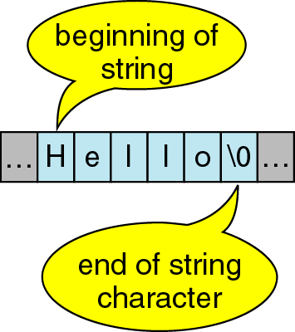
Character Strings
A sequence of characters is often referred to as a character “string”.
A string is stored in an array of type char ending with the null character '\0 '.

Slide 25
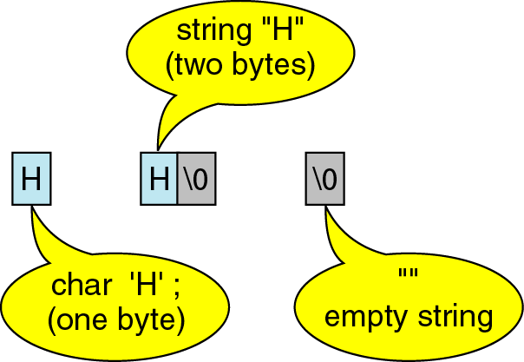
Character Strings
A string containing a single character takes up 2 bytes of storage.

Slide 26
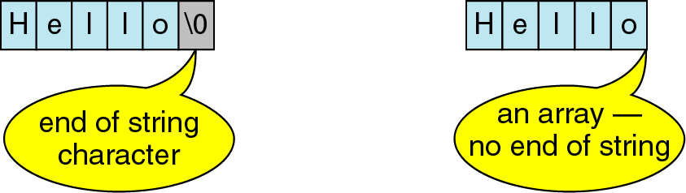
Character Strings

Slide 27
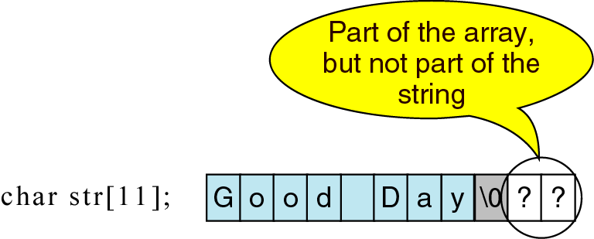
Character Strings

Slide 28
Character vs. String
A string constant is a sequence of characters enclosed in double quotes.
For example, the character string:
char s1[2]="a"; //Takes two bytes of storage.
s1:
On the other hand, the character, in single quotes:
char s2= `a`; //Takes only one byte of storage.
s2:
a | \0
a

Slide 29
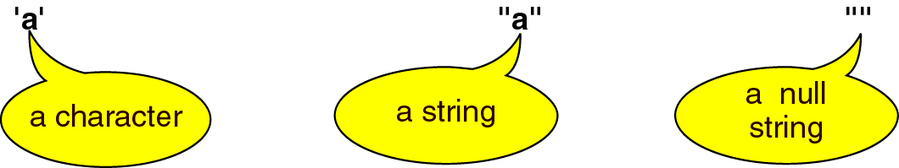
Character vs. String

Slide 30
6.4 Array Examples
Character arrays
char string1[] = "first";
String “first” is really a static array of characters
Character arrays can be initialized using string literals
Null character '\0' terminates strings
string1 actually has 6 elements
It is equivalent to
char string1[] = { 'f', 'i', 'r', 's', 't', '\0' };
Can access individual characters
string1[ 3 ] is character ‘s’

Slide 31

In C, string can be initialized in a number of different ways.
char c[] = "abcd";
OR,
char c[50] = "abcd";
OR,
char c[] = {'a', 'b', 'c', 'd', '\0'};
OR,
char c[5] = {'a', 'b', 'c', 'd', '\0'};

Slide 32
6.4 Array Examples
Array name is address of array, so ‘&’ is not needed for scanf
char string1[20];
scanf( "%s", string1 );
Reads characters until whitespace encountered
Be careful not to write past end of array, as it is possible to do so
Sample Code:
#include <stdio.h>
int main() {
char name[20];
printf("Enter name: ");
scanf("%s", name);
printf("Your name is %s", name);
return 0; }
Output:
Enter name: Ali Zengin
Your name is Ali

Slide 33
Outline
fig06_10.c
(1 of 2 )
string2 array is defined with 15 elements including null character /0

Slide 34
Outline
fig06_11.c
(1 of 4 )

Slide 35
Outline
static array is created only once, when staticArrayInit is first called
fig06_11.c
(2 of 4 )
The static qualifier instructs the compiler to keep a local variable in existence during the life-time of the program. Their default value is zero.

Slide 36
Outline
automatic array is recreated every time automaticArrayInit is called
fig06_11.c
(3 of 4 )

Slide 37
Outline
fig06_11.c
(4 of 4 )

Slide 38
6.5 Passing Arrays to Functions
Passing arrays
To pass an array argument to a function, specify the name of the array without any brackets
int myArray[ 24 ];
myFunction( myArray, 24 );
Array size usually passed to function
Arrays passed call-by-reference
Name of array is address of first element
Function knows where the array is stored
Modifies original memory locations
Passing array elements
Passed by call-by-value
Pass subscripted name (i.e., myArray[ 3 ]) to function

Slide 39
6.5 Passing Arrays to Functions
Function prototype
void modifyArray( int b[], int arraySize );
Parameter names optional in prototype
int b[] could be written int []
int arraySize could be simply int

Slide 40
Performance Tip 6.3
Passing arrays by reference (address) is for performance reasons.
If arrays were passed by value, a copy of each element would be passed.

Slide 41
Outline
fig06_12.c

Slide 42
Single element of an array can be passed in similar manner as passing variable to a function.
C program to pass a single element of an array to function:
#include <stdio.h>
void display(int age)
{
printf("%d", age);
}
int main()
{
int ageArray[] = { 2, 3, 4 };
display(ageArray[2]); //Passing array element by value only.
return 0;
}
Output
4

Slide 43
Passing an entire one-dimensional array to a function
While passing arrays as arguments to the function, only the name of the array is passed (,i.e, starting address of memory area is passed as argument)
#include <stdio.h>
float average(float age[]);
int main()​
{
float avg, age[] = { 23.4, 55, 22.6, 3, 40.5, 18 };
avg = average(age); /* Only name of array is passed as argument. */
printf("Average age=%.2f", avg);
return 0;
}
float average(float age[])
{
int i;
float avg, sum = 0.0;
for (i = 0; i < 6; ++i) {
sum += age[i];
}
avg = (sum / 6);
return avg;
}

Slide 44
Outline
Function prototype indicates function will take an array
fig06_13.c
(1 of 3 )
Array a is passed to modifyArray by passing only its name

Slide 45
Outline
fig06_13.c
(2 of 3 )
Array element is passed to modifyElement by passing a[ 3 ]

Slide 46
Outline
fig06_13.c
(3 of 3 )

Slide 47
Outline
fig06_14.c
(1 of 2 )
const qualifier tells compiler that array cannot be changed and is used prevent the original array from being modified in the function body
Any attempts to modify the array will result in errors

Slide 48
Software Engineering Observation 6.3
The const type qualifier can be applied to an array parameter in a function definition to prevent the original array from being modified in the function body.
Functions should not be given the capability to modify an array unless it is absolutely necessary.

Slide 49
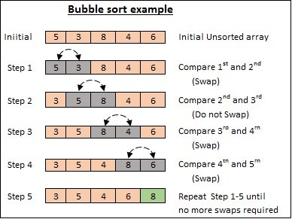
6.6 Sorting Arrays
Sorting data
Important computing application
Virtually every organization must sort some data
Bubble sort (sinking sort)
Several passes through the array
Successive pairs of elements are compared
If increasing order (or identical ), no change
If decreasing order, elements exchanged
Repeat
Example:
original: 3 4 2 6 7
pass 1: 3 2 4 6 7
pass 2: 2 3 4 6 7
Small elements "bubble" to the top

Slide 50
Bubble sort
Several passes through the array

Slide 51
Performance Tip 6.4
Often, the simplest algorithms perform poorly. Their virtue is that they are easy to write, test and debug. However, more complex algorithms are often needed to realize maximum performance.

Slide 52
Outline
fig06_15.c
(1 of 2 )

Slide 53
Outline
If any two array elements are out of order, the function swaps them
fig06_15.c
(2 of 2 )

Slide 54
6.7 Case Study: Computing Mean, Median and Mode Using Arrays
Mean – average
Median – number in middle of sorted list
1, 2, 3, 4, 5
3 is the median
Mode – number that occurs most often
1, 1, 1, 2, 3, 3, 4, 5
1 is the mode

Slide 55
Outline
fig06_16.c
(1 of 6 )

Slide 56
Outline
fig06_16.c
(2 of 6 )

Slide 57
Outline
fig06_16.c
(3 of 6 )
Once the array is sorted, the median will be the value of the middle element

Slide 58
Outline
fig06_16.c
(4 of 6 )

Slide 59
Outline
fig06_16.c
(5 of 6 )

Slide 60
Outline
fig06_16.c
(6 of 6 )

Slide 61
Outline
(1 of 2 )

Slide 62
Outline
(2 of 2 )

Slide 63
6.8 Searching Arrays
Search an array for a key value
Linear search
Simple
Compare each element of array with key value
Useful for small and unsorted arrays

Slide 64
Outline
fig06_18.c
(1 of 3 )

Slide 65
Outline
fig06_18.c
(2 of 3 )

Slide 66
Outline
Linear search algorithm searches through every element in the array until a match is found
fig06_18.c
(3 of 3 )

Slide 67
6.8 Searching Arrays
Binary search
For sorted arrays only
Compares middle element with key
If equal, match found
If key < middle, looks in first half of array
If key > middle, looks in last half
Repeat
Very fast; at most n steps, where 2^{n} > number of elements
30 element array takes at most 5 steps
2⁵ > 30 so at most 5 steps

Slide 68
Outline
fig06_19.c
(1 of 6 )

Slide 69
Outline
fig06_19.c
(2 of 6 )

Slide 70
Outline
If value is found, return its index
fig06_19.c
(3 of 6 )
If value is too high, search the left half of array
If value is too low, search the right half of array

Slide 71
Outline
fig06_19.c
(4 of 6 )

Slide 72
Outline
fig06_19.c
(5 of 6 )

Slide 73
Outline
fig06_19.c
(6 of 6 )

Slide 74
6.9 Multiple-Subscripted Arrays
Multiple subscripted arrays
Tables with rows and columns (m by n array)
Like matrices: specify row, then column
Initialization
int b[ 2 ][ 2 ] = { { 1, 2 }, { 3, 4 } };
Initializers grouped by row in braces
If not enough, unspecified elements set to zero
int b[ 2 ][ 2 ] = { { 1 }, { 3, 4 } };
1st row
2nd row
First row and second column of array is equal to 0

Slide 75
6.9 Multiple-Subscripted Arrays
Referencing elements
int b[ 2 ][ 2 ] = { { 1, 2 }, { 3, 4 } };
printf( "%d", b[ 0 ][ 1 ] );
1st row
2nd column
Result = 2

Slide 76
Common Programming Error 6.9
C interprets a[ x, y ] as a[ y ], and as such it does not cause a syntax error.
Common programming error is rreferencing a double-subscripted array element as a[ x, y ] instead of a[ x ][ y ].

Slide 77
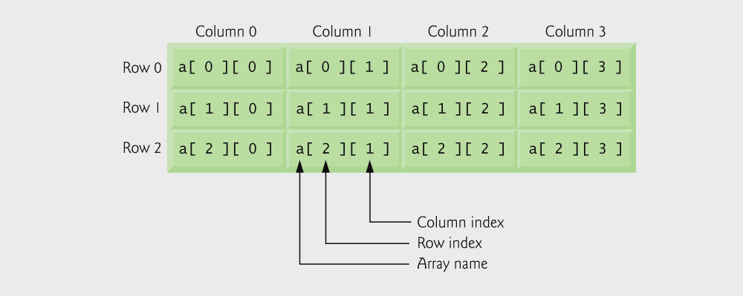
Fig. 6.20 | Double-subscripted array with three rows and four columns.

Slide 78
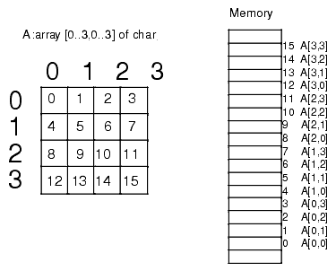
Array in a computer memory
1st row
Therefore, number of columns in an array is important!

Slide 79
number of columns
Outline
fig06_21.c
(1 of 2 )
array1 is initialized with both rows full
array2 and array3 are initialized only partially

Slide 80
Outline
fig06_21.c
(2 of 2 )

Slide 81
Outline
fig06_22.c
(1 of 6 )
Each row in the array corresponds to a single student’s set of grades

Slide 82
Outline
fig06_22.c
(2 of 6 )
The address of each row is given to the function

Slide 83
Outline
fig06_22.c
(3 of 6 )

Slide 84
Outline
fig06_22.c
(4 of 6 )

Slide 85
Outline
fig06_22.c
(5 of 6 )

Slide 86
Outline
fig06_22.c
(6 of 6 )

